Slide 1
The Bakery In The Making
Integrated Project: Desree Riba

Slide 2
Project Background
Small businesses in rural areas struggle to maintain their operations and make strategic plans while barely scraping by. This is because they have very little capital and very little funding, which forces them to work hard just to make it to the next order or delivery. As a result, many small businesses lack adequate planning for the future, performance visibility, and understanding of their daily operations.
Another factor causing many of these organizations to regress is a lack of awareness about the resources available to help with the day-to-day management of the company, such as reports and well-documented business procedures.
This was the case with Daisy’s Oven, a small bakery based in the deep rurals of Limpopo in a small town called Burgersfort.
As someone who is passionate about small businesses and Data Science, this project will try to support Daisy's Oven in planning for their orders, adequate visibility on their work, and future planning

Slide 3
Problem Statement
Problem: Daisy’s Oven struggles to meet all orders in some months whereas they also have too many ingredients that go bad due to not enough orders in other months.
Objectives: The goal of this project is to give Daisy’s Oven visibility in terms of their orders and what their clients order the most and on which months and also assist them plan accordingly.

Slide 4
Project landscaping
Orders are written down in an order book. Which outlines the name of the customer, the order type, theme, color, size, prize and occasion among other things.
Data is only available in this order booked which is controlled by the business owner Daisy.
Currently there is no structured way the data is being stored.
This data in a log book can potentially be structured by creating a excel file and properly write down information an orderly manner.
A template can be created for the owner for ease of reference.
With data structured like this, no reporting is being done and there is no visibility on the business operations. Creating a powerbi report can assist with this problem.

Slide 5
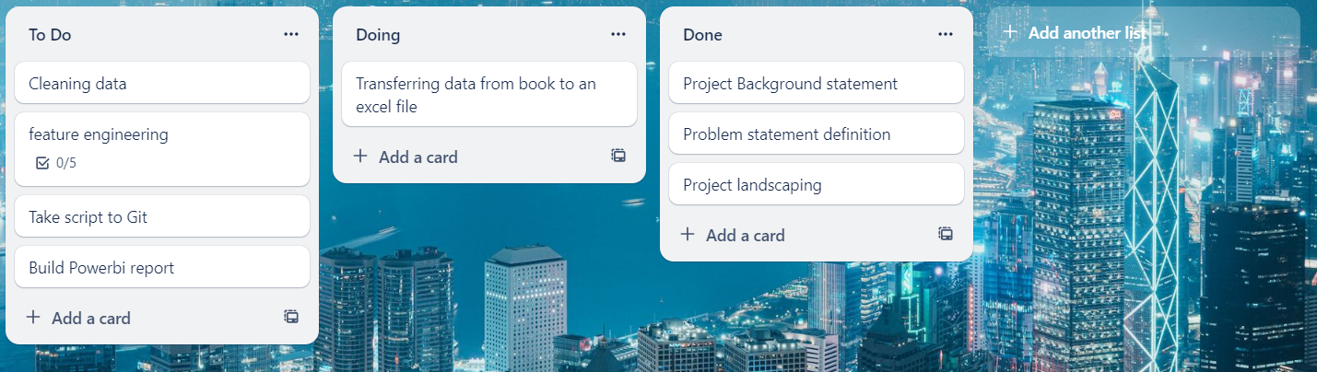
Project planning

Slide 6
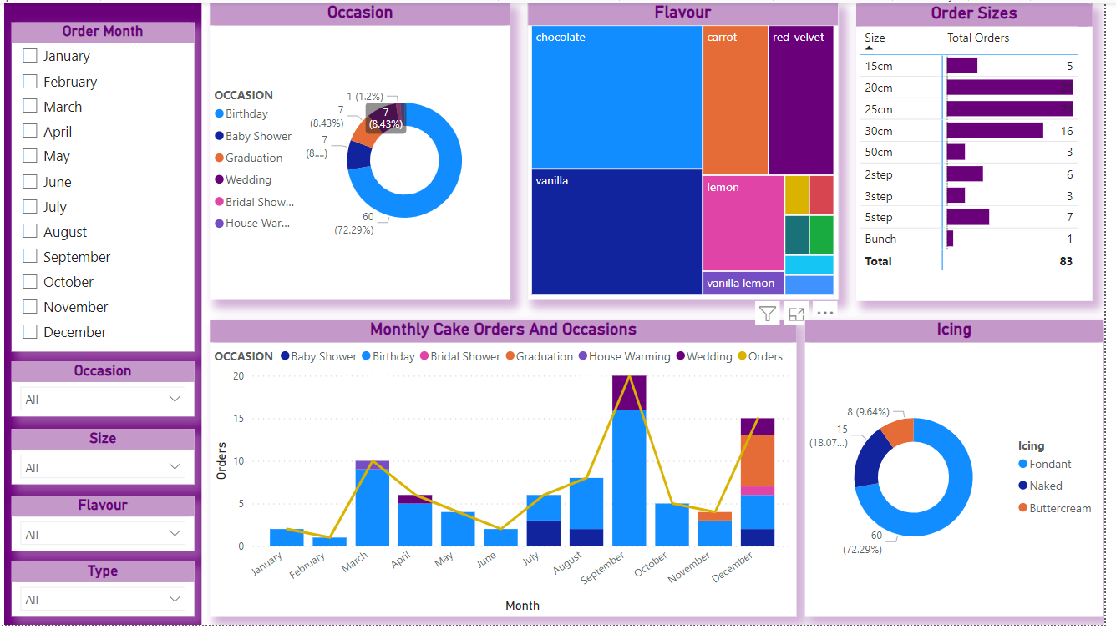
Report
See accompanying powerBi report for more.

Slide 7
What’s next for daisy’s oven
Daisy will start keeping a proper report or proper track of her orders by continuing with the template created when making this report.
More details are to be included like how much it costs for each ingredients.
A model will be built for her to better prepare for her orders.
Pricing will be evaluated given the insights form this report.

